Slide 1
딥러닝 이론 교육
CNN Architecture
Joonhyeon Park <junpark25@ajou.ac.kr>

Slide 2
Summary

Slide 3
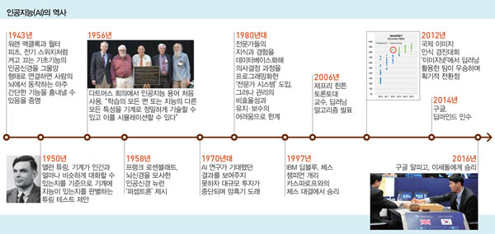
History of AI

Slide 4
Supervised/Unsupervised Learning
Supervised Learning | Classification | kNN
 |  | Naïve Bayes
 |  | Support Vector
 |  | Machine Decision
 |  | Deep Learning
 | Regression | Linear Regression
 |  | Locally Weighted Linear
 |  | Ridge
 |  | Lasso
 |  | Deep Learning
Unsupervised Learning |  | Clustering
 |  | K Means
 |  | Density Estimation
 |  | Exception Maximization
 |  | Pazen Window
 |  | DBSCAN
 |  | Deep Learning

Slide 5
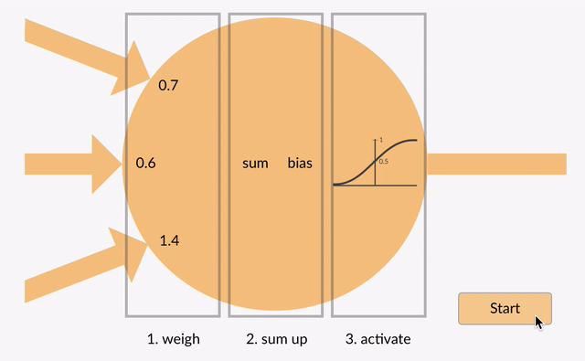
Artificial Neural Network

Slide 6
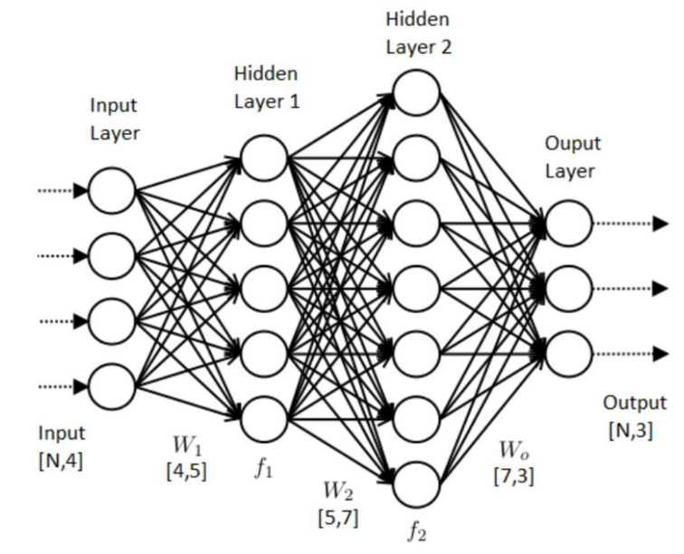
Multi-layered Neural Network

Slide 7
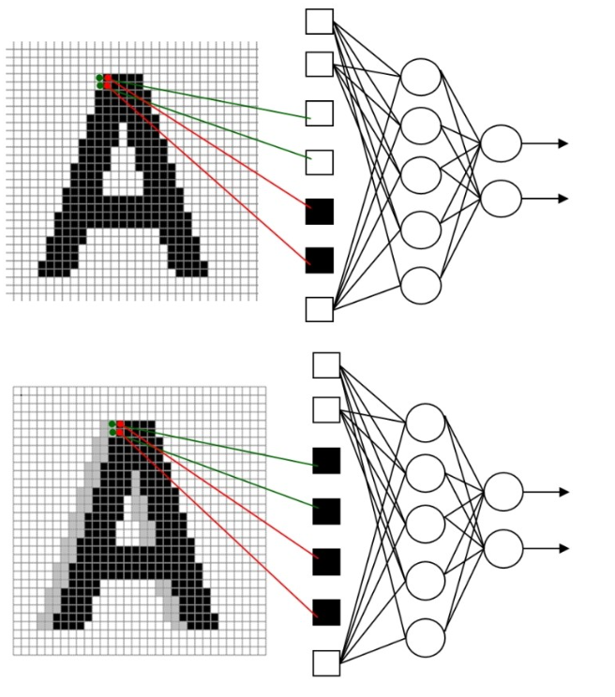

Convolution Neural Network
Problems of MLP

Slide 8

Convolution Neural Network

Slide 9
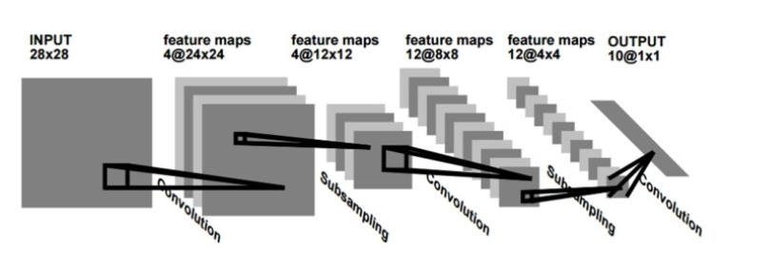
Convolution Neural Network - LeNet

Slide 10
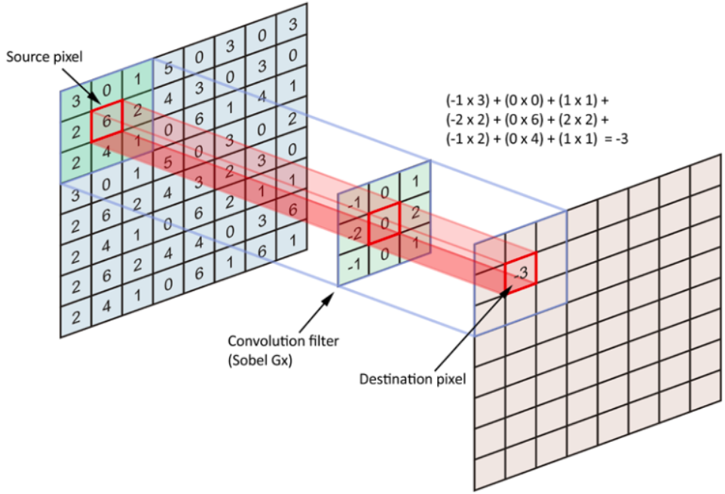
Convolution Neural Network
Input Feature
Output Feature

Slide 11
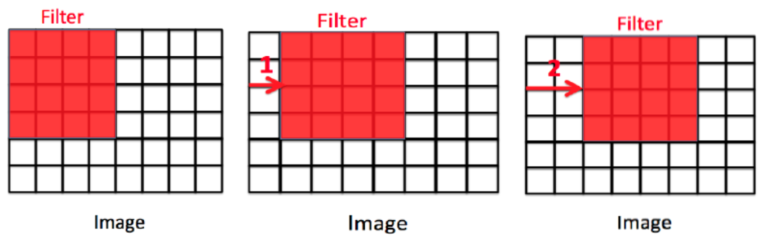
Convolution Neural Network
Stride

Slide 12
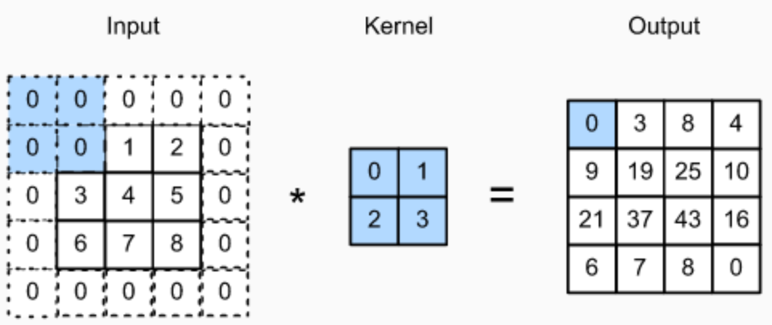
Convolution Neural Network
Padding

Slide 13
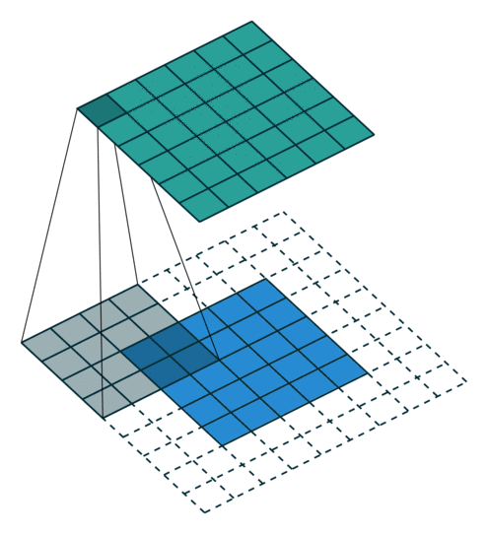
Convolution Neural Network
Ex) Filter Size = (4,4), Stride= 1, Padding size =2

Slide 14

Convolution Neural Network
Ex) Filter Size = (3,3), Stride= 2, Padding size = 0

Slide 15
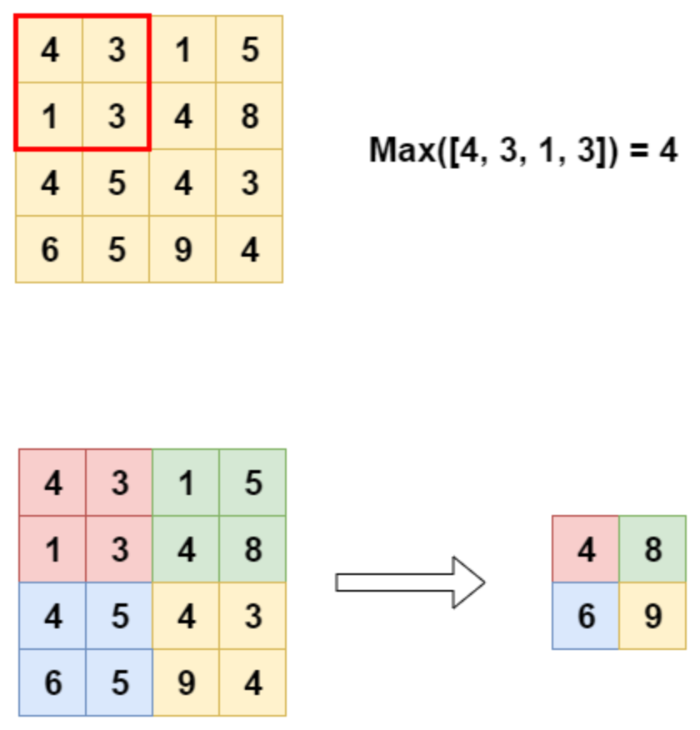
Convolution Neural Network
Pooling Layer

Slide 16
Convolution Neural Network - LeNet
1998

Slide 17
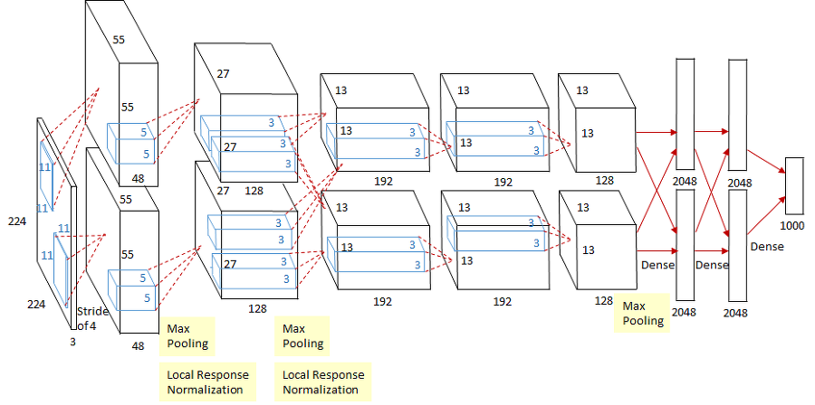
Convolution Neural Network - AlexNet
2012

Slide 18
Convolution Neural Network – AlexNet
Activation Function - ReLu
a
b
c
x
y
F(x)
G(x)
H(x)
Y=H(G(F(x))) = a ∙ b ∙ c ∙ x

Slide 19
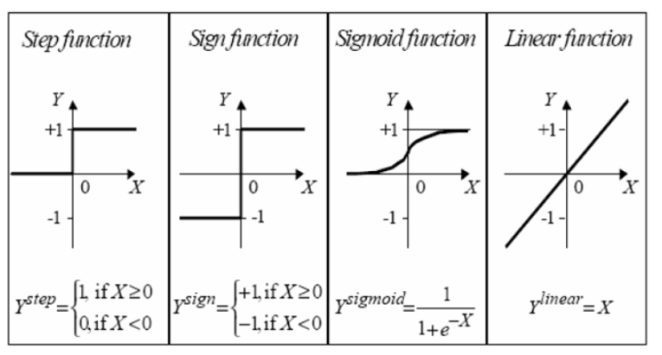
Convolution Neural Network – AlexNet
Activation Function - ReLu

Slide 20
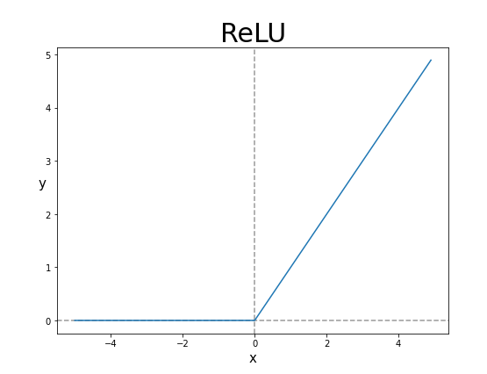
Convolution Neural Network – AlexNet
Activation Function - ReLu

Slide 21
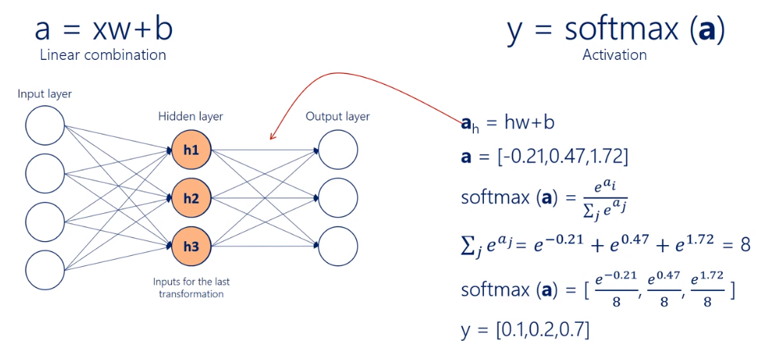
Convolution Neural Network – AlexNet
Activation Function - Softmax

Slide 22
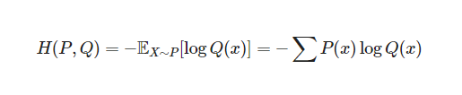
Convolution Neural Network – AlexNet
Cost Function = Loss Function
Cross-Entropy Loss

Slide 23
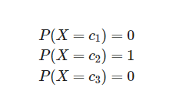
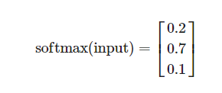
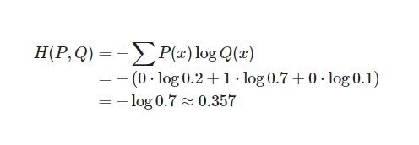
Convolution Neural Network – AlexNet
Cost Function = Loss Function
Cross-Entropy Loss

Slide 24
Convolution Neural Network – AlexNet
Batch Normalization

Slide 25
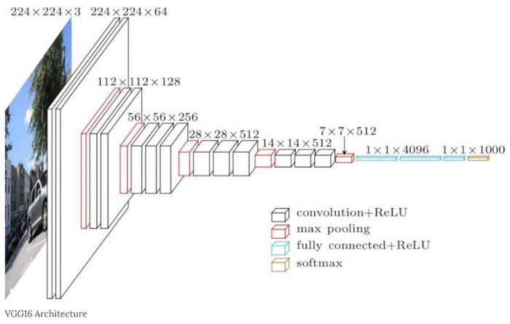
Convolution Neural Network – VGG16
2014

Slide 26
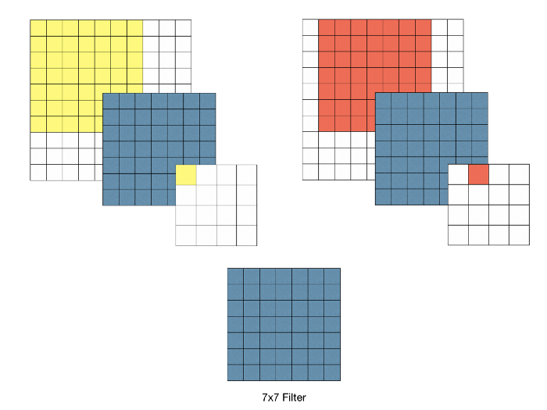
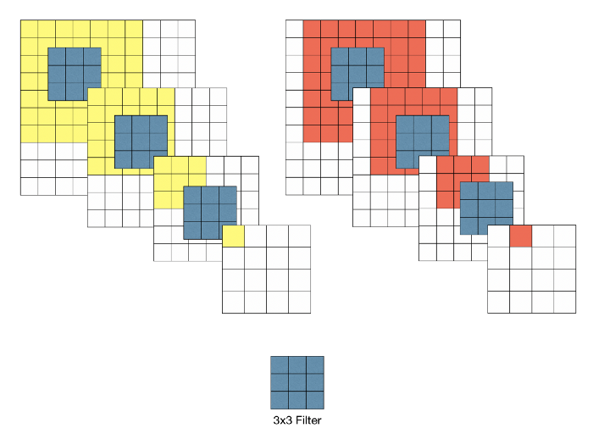
Convolution Neural Network – VGG16
7x7 filter vs 3x3 filter
Weight = 49
Weight = 9 x3 =27

Slide 27
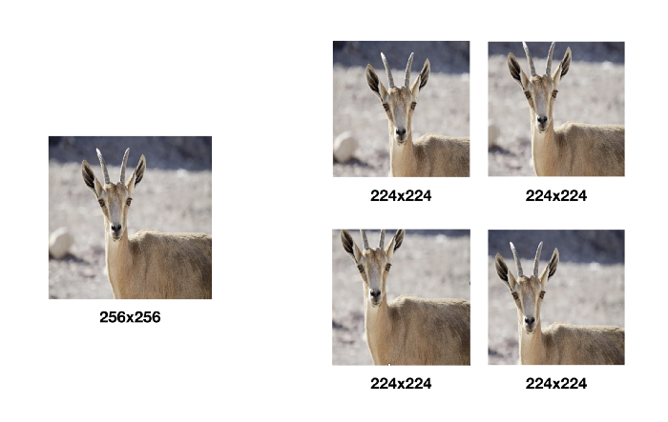
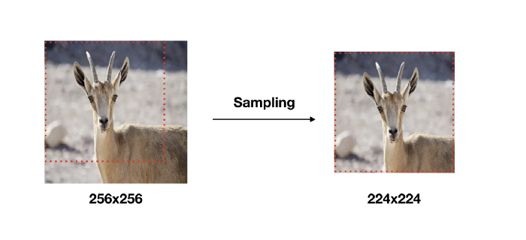
Convolution Neural Network – VGG16
Data Augmentation

Slide 28
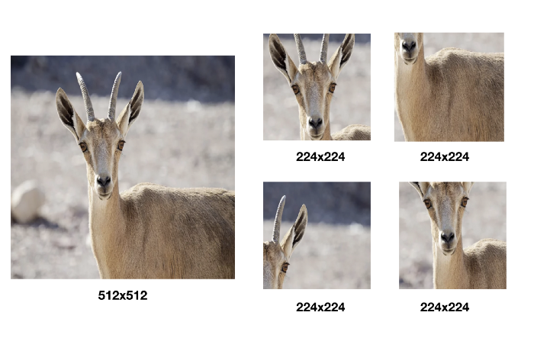
Convolution Neural Network – VGG16
Data Augmentation

Slide 29
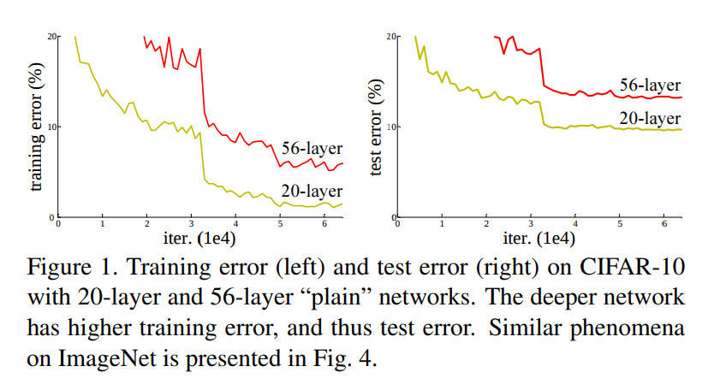
Convolution Neural Network – ResNet
Degradation Problem

Slide 30
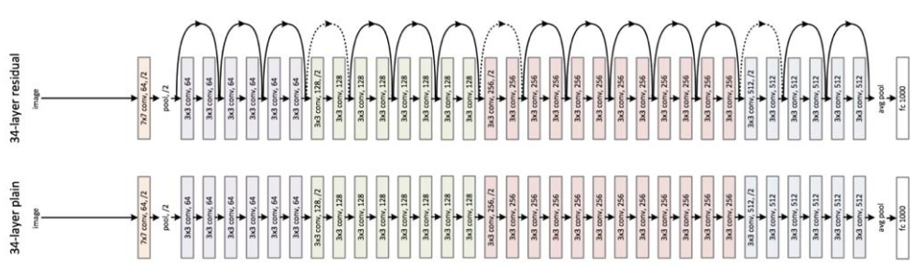
Convolution Neural Network – ResNet
2015

Slide 31
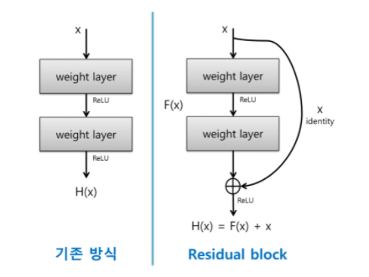
Convolution Neural Network – ResNet
Residual = Skip Connection

Slide 32
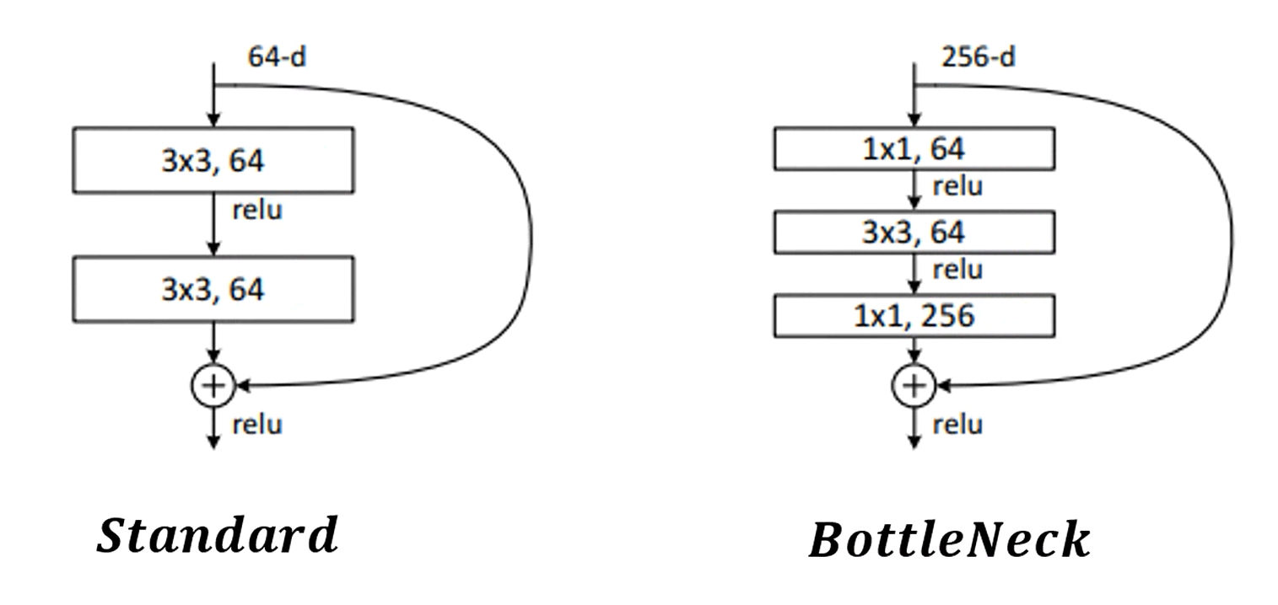
Convolution Neural Network – ResNet
BottleNeck

Slide 33
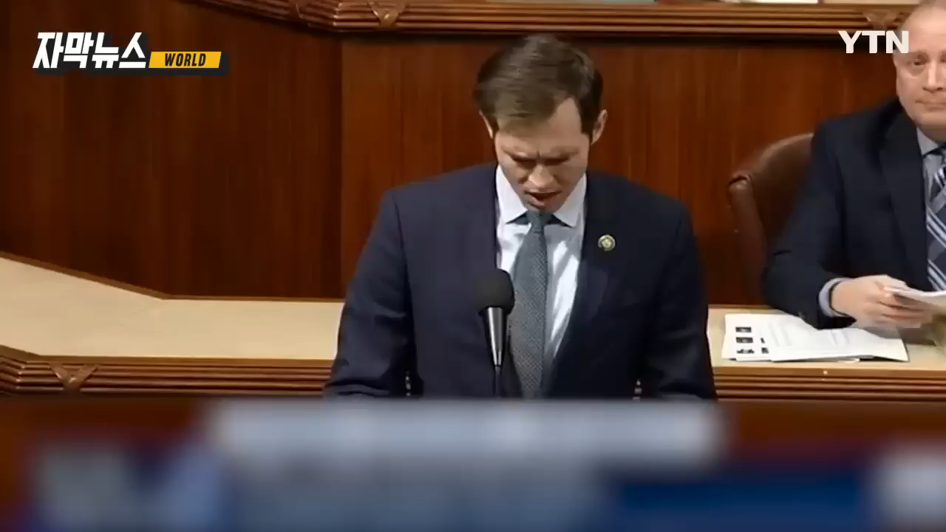

Slide 34
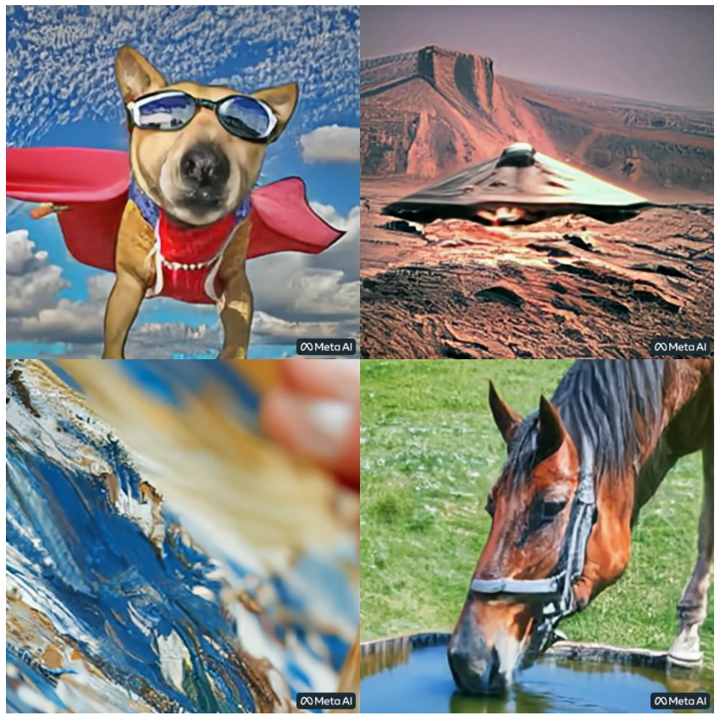
https://makeavideo.studio/

Slide 35
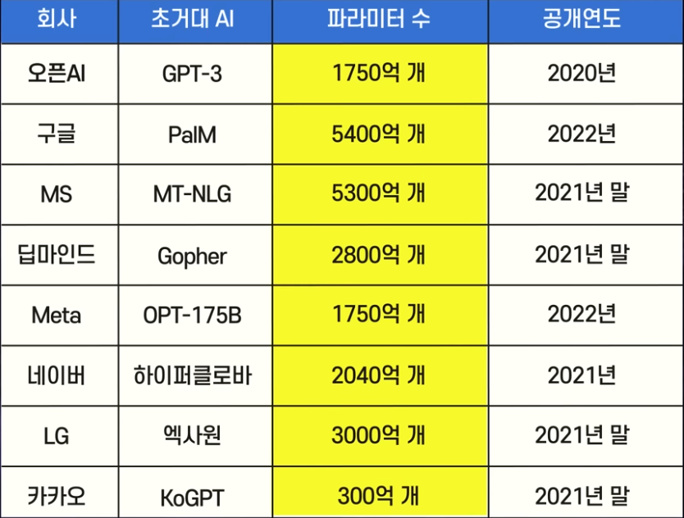

Slide 36

초거대 AI

Slide 37
Lab 1 : XOR

Slide 38
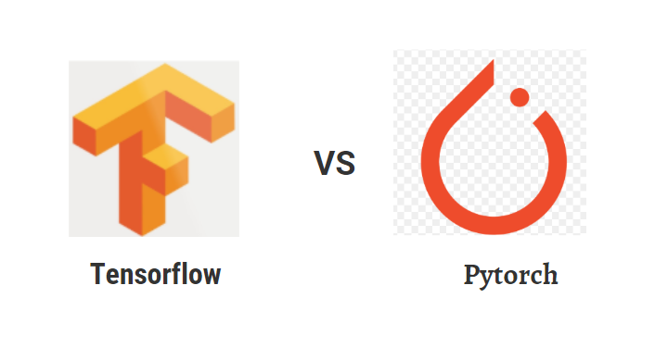
Deep Learning Library

Slide 39
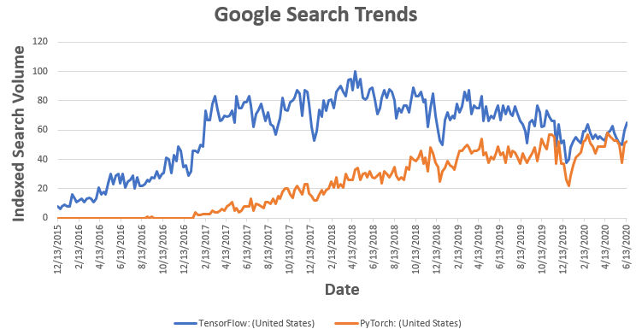
Deep Learning Library

Slide 40
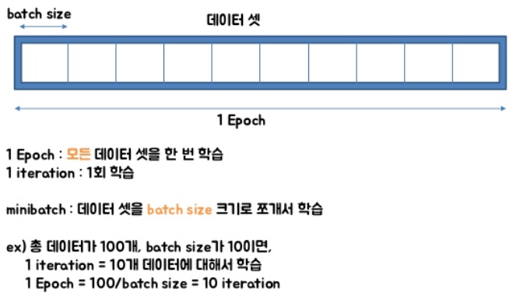

Slide 41
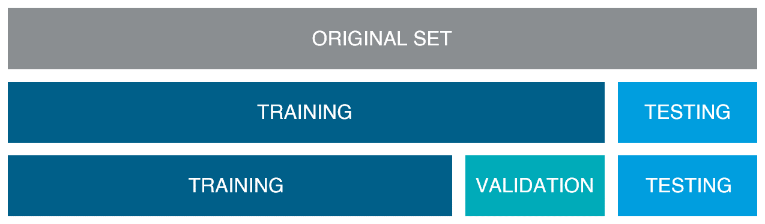
Training, Validation, Test

Slide 42
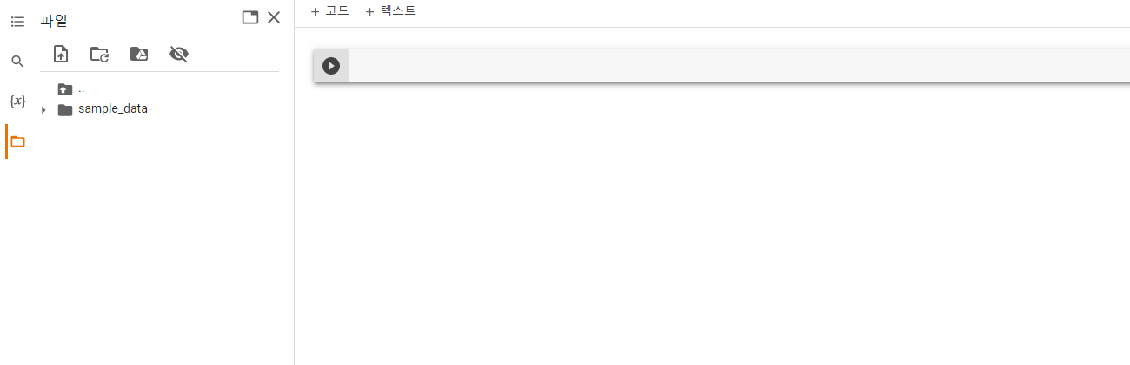


Slide 43
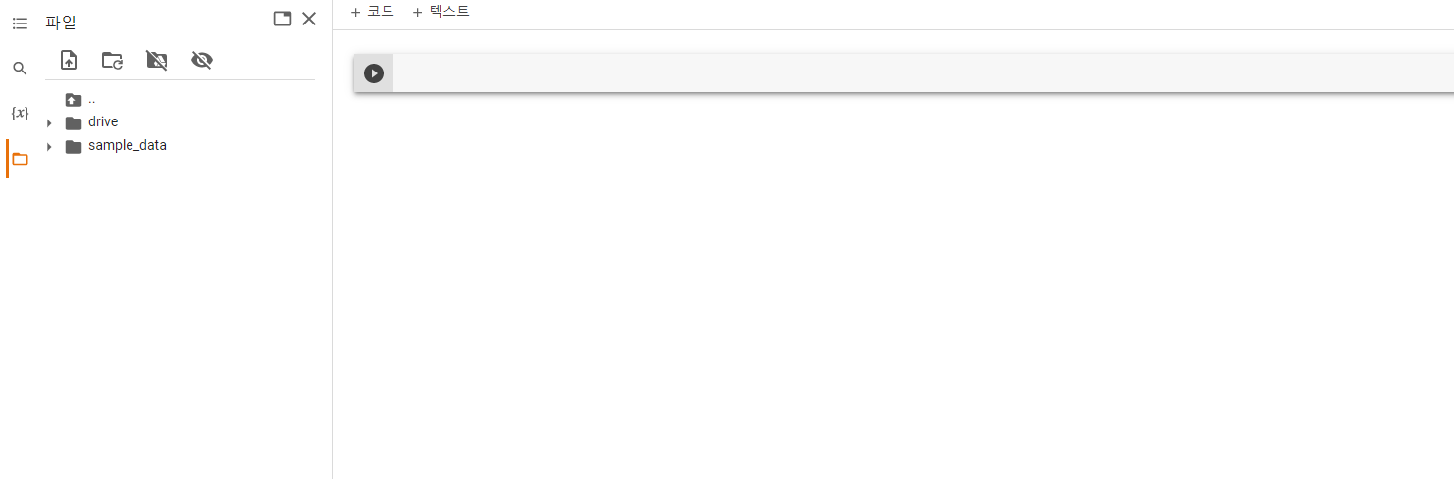

Slide 44
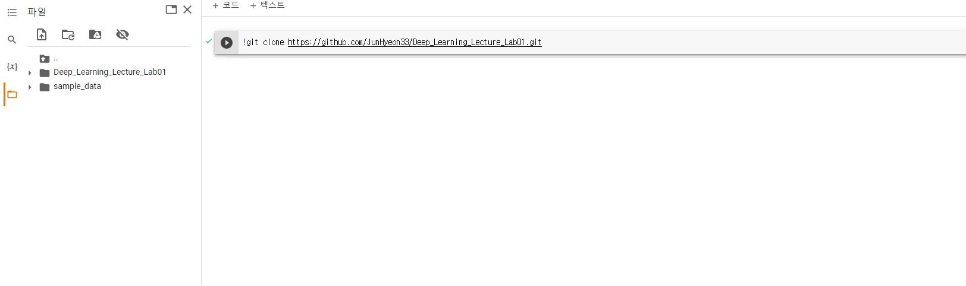
!git clone https://github.com/JunHyeon33/Deep_Learning_Lecture_Lab01.git

Slide 45
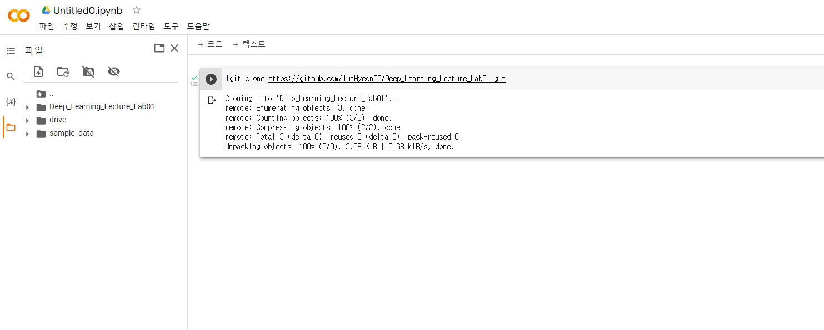
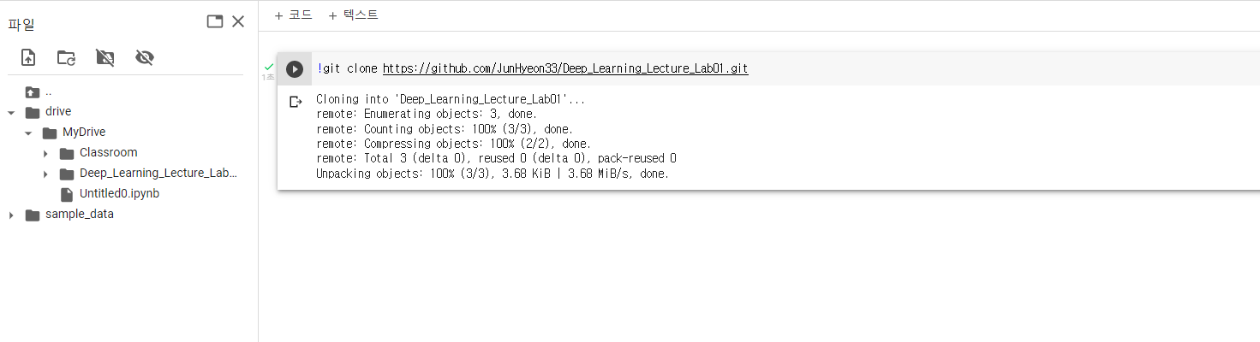
Drag해서 drive/MyDrive로 폴더 이동

Slide 46
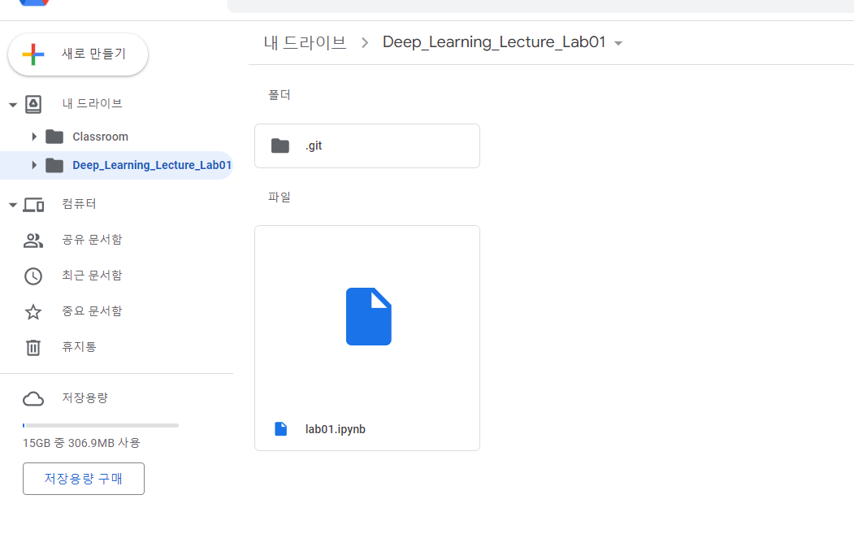

Slide 48
Lab 2 : CNN

Slide 49
!git clone https://github.com/JunHyeon33/Deep_Learning_Lecture_Lab01.git
!git clone https://github.com/JunHyeon33/Deep_Learning_Lecture_Lab02.git

Slide 50
Drag해서 drive/MyDrive로 폴더 이동

